Slide 1
Kaggle Formular 1 Data Pipeline Project

Slide 2
Project Overview
A complex project that unleashes the power of data engineering pipeline to solve organizational problems. The primary goal was to use concepts, tools, applications in data engineering to understand some challenges that Formular 1 sports field. Formular 1 sport had a challenge to organize data from teams, winners, drivers into a core platform for further analysis by data scientist.

Slide 3
-Role
Senior Data Engineer
The responsibility was to design concept model to highlight the whole project from infancy to final stage
The framework was to identify key technologies in data engineering that would reduce the collection of data, cleaning and making it available for other users
Prefect flow to orchestrions the whole design concepts
Pull formular data from Kaggle platform
Normalize the dataset to required format
The data transformation stage was to remove null vales, insert new columns

Slide 4
Cloud Platform
Terraform platform to create s3 bucket, redshift databases, IAM role to access s3 bucket from redshift
Inject the transformed dataset into data warehouse that’s s3 bucket platform
Pull the final dataset into redshift
Visualize the aggregate data from teams, winners, drivers and laps

Slide 5
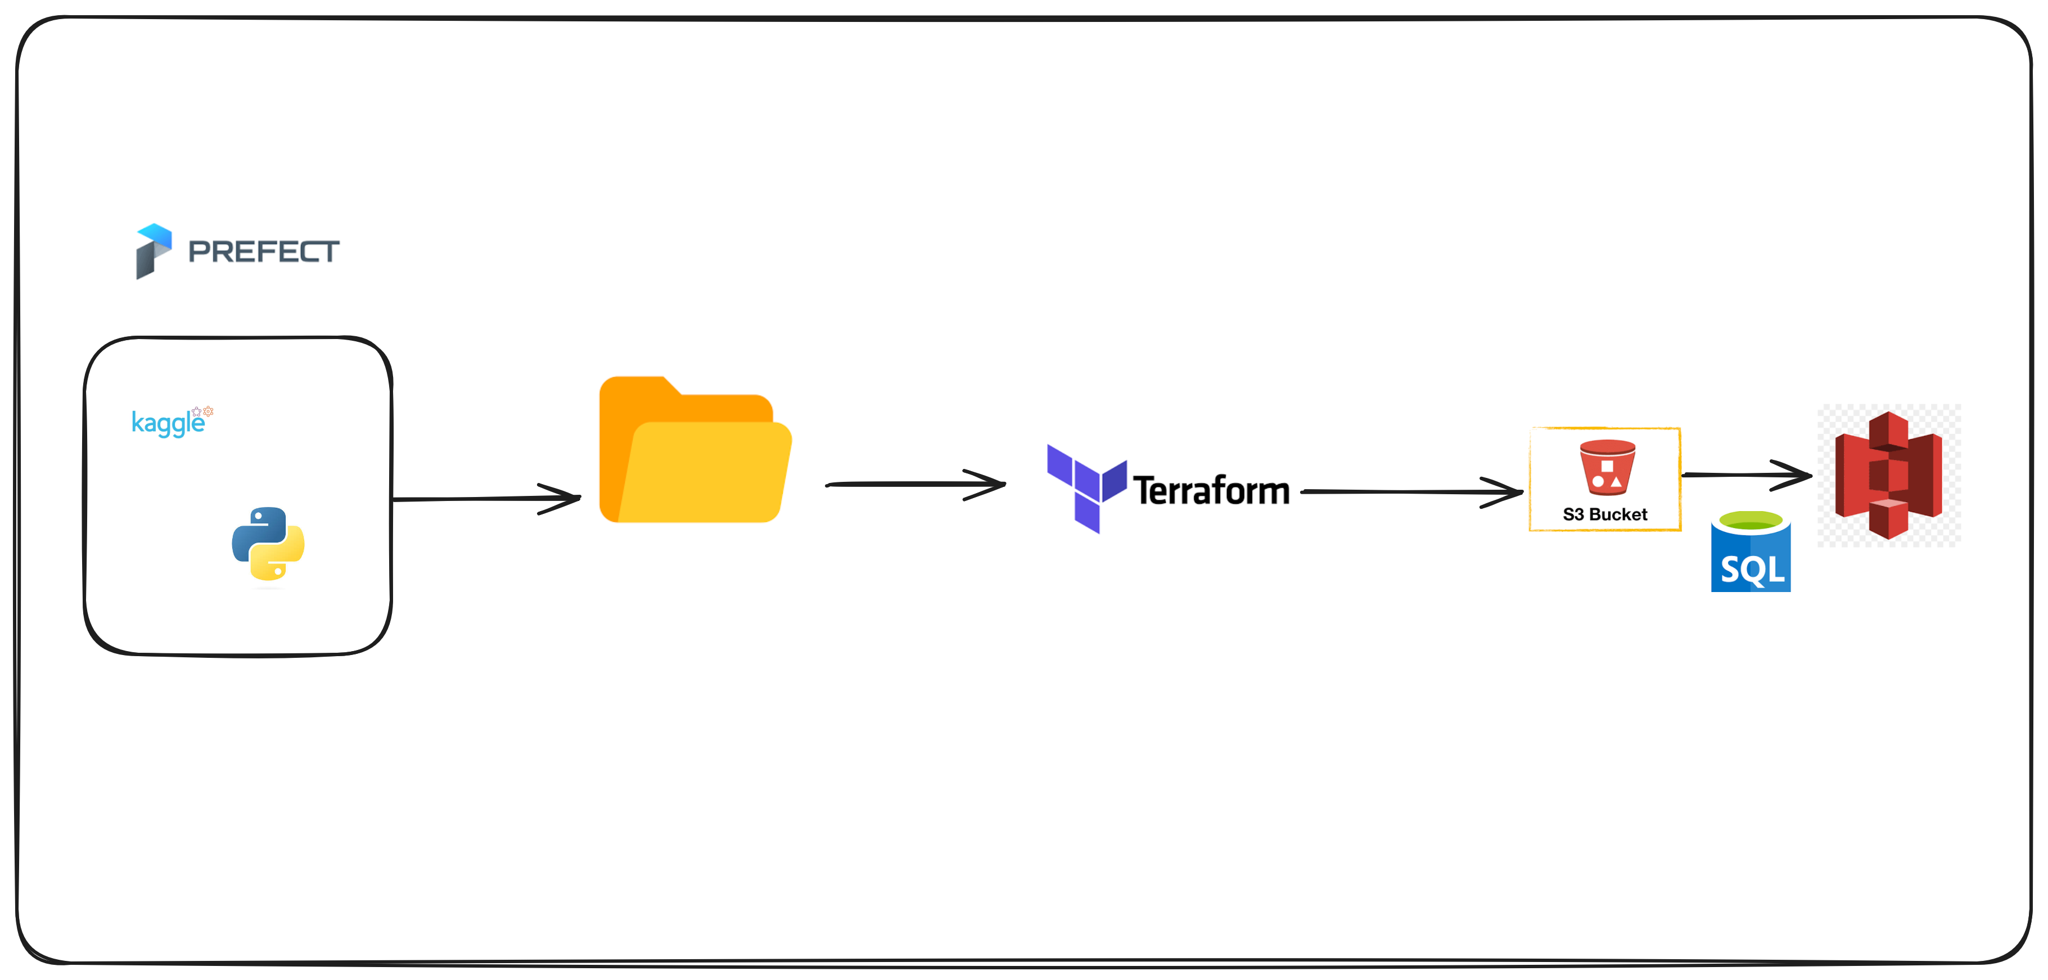

Slide 6
Technical Challenges
The technical challenge was incorporate various data from Kaggle into a central source.
Airflow platform library didn’t harness the library of Kaggle Api
Defining data accuracy and consistency between data pipeline and Kaggle dataset

Slide 7
Solution Approach
To address these challenges, a comprehensive approach was adopted. Modern data engineering tools and technologies
Orchestration platform Prefect mitigated the missing Kaggle library in Airflow.
Efficient ETL processes were established to transform and load data into a well-structured data warehouse.
Data modeling techniques were implemented to make data readily available for analytics and reporting.

Slide 8
Results and Impact
The project improves the general access time of formular analysist, real time access to transformed data during live races.
The project also led to efficiency improvements and cost savings by automating data updates through scheduled queries.

Slide 9
Lessons Learned
Effective ETL underscored the relevant of data engineering in sports filed arena.
It underscored the significance importance of continuous learning and up skilling once filed.
Develop concept thinking to break huge projects into smaller task.

Slide 10
Team Collaboration
Collaboration with cross-functional teams, including data analysts and business stakeholders, was key.
Effective communication of technical concepts to non-technical stakeholders ensured alignment with business objectives.

Slide 11
Adaptability
The project required an adaptive ETL to handle the ever-changing shape of dataset from Kaggle platform
Technical Tools and Technologies
Tools and technologies leveraged in Project Included DBT, Prefect, SQL, Python, and AWS S3, Redshift data warehouse
These technologies enabled efficient data modeling, ETL processes, and data warehousing.

Slide 12
Closing Statement
This project exemplifies my ability to handle complex data engineering challenges, collaborate effectively with teams, and deliver impactful solutions.
I am enthusiastic about applying these experiences and skills in any organization that I would find myself. My sole mission is to enabling data-driven decision-making in the fintech industry. I am genuinely passionate about leveraging data to transform businesses and look forward to the opportunities in any organization.
Github Link: https://github.com/datsitsre/kaggle_data_pipeline.git

